Slide 1
Chapter 8
Formal Specification

Slide 2
Objectives
To explain why formal specification techniques help discover problems in system requirements
To describe the use of algebraic techniques for interface specification
To describe the use of model-based techniques for behavioural specification

Slide 3
Topics covered
Formal specification in the software process
Sub-system interface specification
Behavioural specification

Slide 4
Formal methods
Formal specification is part of a more general collection of techniques that are known as ‘formal methods’.
These are all based on mathematical representation and analysis of software.
Formal methods include
  Formal specification;
  Specification analysis and proof;
  Transformational development;
  Program verification.

Slide 5
Acceptance of formal methods
Formal methods have not become mainstream software development techniques as was once predicted
  Other software engineering techniques have been successful at increasing system quality. Hence the need for formal methods has been reduced;
  Market changes have made time-to-market rather than software with a low error count the key factor. Formal methods do not reduce time to market;
  The scope of formal methods is limited. They are not well-suited to specifying and analysing user interfaces and user interaction;
  Formal methods are still hard to scale up to large systems.

Slide 6
Use of formal methods
The principal benefits of formal methods are in reducing the number of faults in systems.
Consequently, their main area of applicability is in critical systems engineering. There have been several successful projects where formal methods have been used in this area.
In this area, the use of formal methods is most likely to be cost-effective because high system failure costs must be avoided.

Slide 7
Specification in the software process
Specification and design are inextricably
intermingled.
Architectural design is essential to structure a specification and the specification process.
Formal specifications are expressed in a
mathematical notation with precisely defined vocabulary, syntax and semantics.

Slide 8
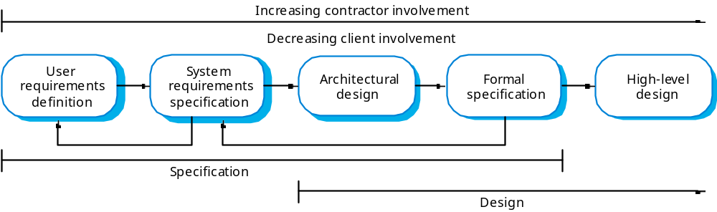
Specification and design

Slide 9
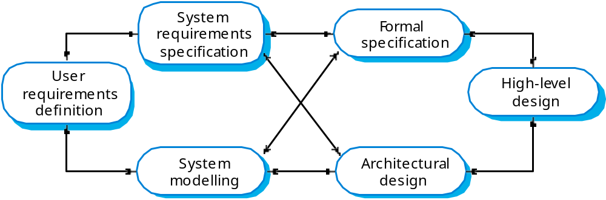
Specification in the software process

Slide 10
Use of formal specification
Formal specification involves investing more effort in the early phases of software development.
This reduces requirements errors as it forces a detailed analysis of the requirements.
Incompleteness and inconsistencies can be discovered and resolved.
Hence, savings as made as the amount of rework due to requirements problems is reduced.

Slide 11
Cost profile
The use of formal specification means that the cost profile of a project changes
  There are greater up front costs as more time and effort are spent developing the specification;
  However, implementation and validation costs should be reduced as the specification process reduces errors and ambiguities in the requirements.

Slide 12
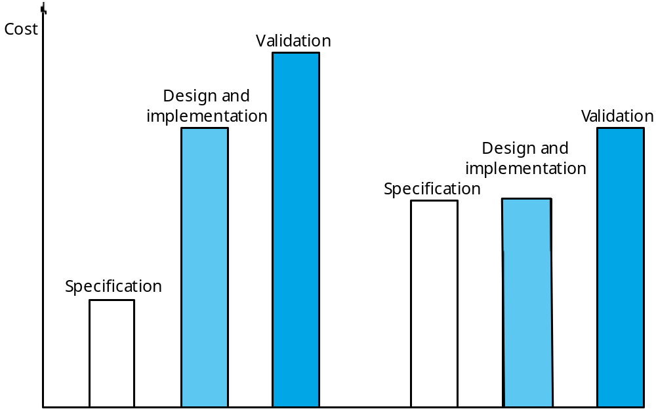
Development costs with formal specification

Slide 13
Specification techniques
Algebraic specification
  The system is specified in terms of its operations and their relationships.
Model-based specification
  The system is specified in terms of a state model that is constructed using mathematical constructs such as sets and sequences. Operations are defined by modifications to the system’s state.

Slide 14
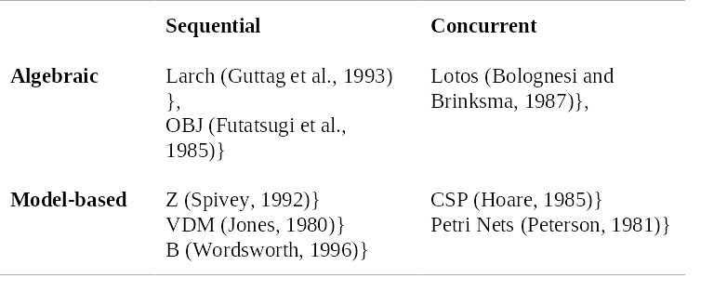
Formal specification languages

Slide 15
Interface specification
Large systems are decomposed into subsystems with well-defined interfaces between these subsystems.
Specification of subsystem interfaces allows independent development of the different subsystems.
Interfaces may be defined as abstract data types or object classes.
The algebraic approach to formal specification is particularly well-suited to interface specification as it is focused on the defined operations in an object.

Slide 16
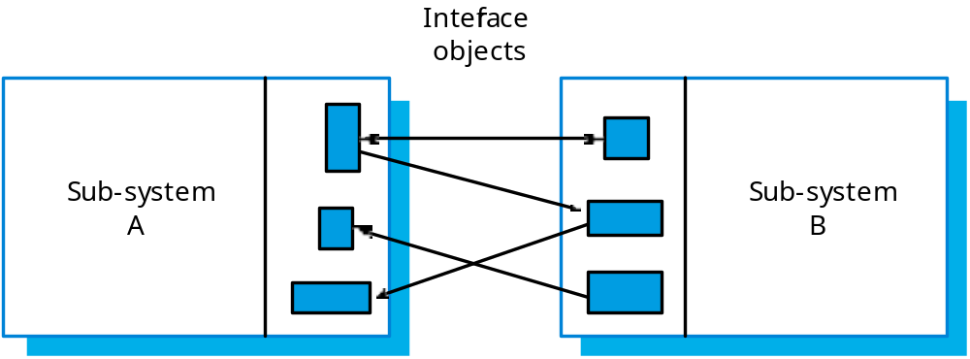
Sub-system interfaces

Slide 17
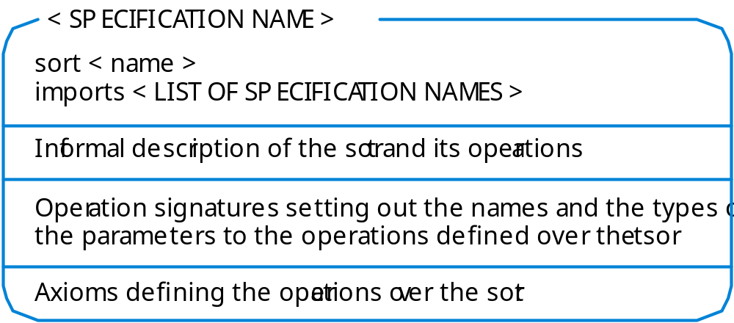
The structure of an algebraic specification

Slide 18
Specification components
Introduction
  Defines the sort (the type name) and declares other specifications that are used.
Description
  Informally describes the operations on the type.
Signature
  Defines the syntax of the operations in the interface and their parameters.
Axioms
  Defines the operation semantics by defining axioms which characterise behaviour.

Slide 19
Systematic algebraic specification
Algebraic specifications of a system may be developed in a systematic way
  Specification structuring;
  Specification naming;
  Operation selection;
  Informal operation specification;
  Syntax definition;
  Axiom definition.

Slide 20
Specification operations
Constructor operations. Operations which create entities of the type being specified.
Inspection operations. Operations which evaluate entities of the type being specified.
To specify behaviour, define the inspector operations for each constructor operation.

Slide 21
Operations on a list ADT
Constructor operations which evaluate to sort List
  Create, Cons and Tail.
Inspection operations which take sort list as a parameter and return some other sort
  Head and Length.
Tail can be defined using the simpler
constructors Create and Cons. No need to define Head and Length with Tail.

Slide 22
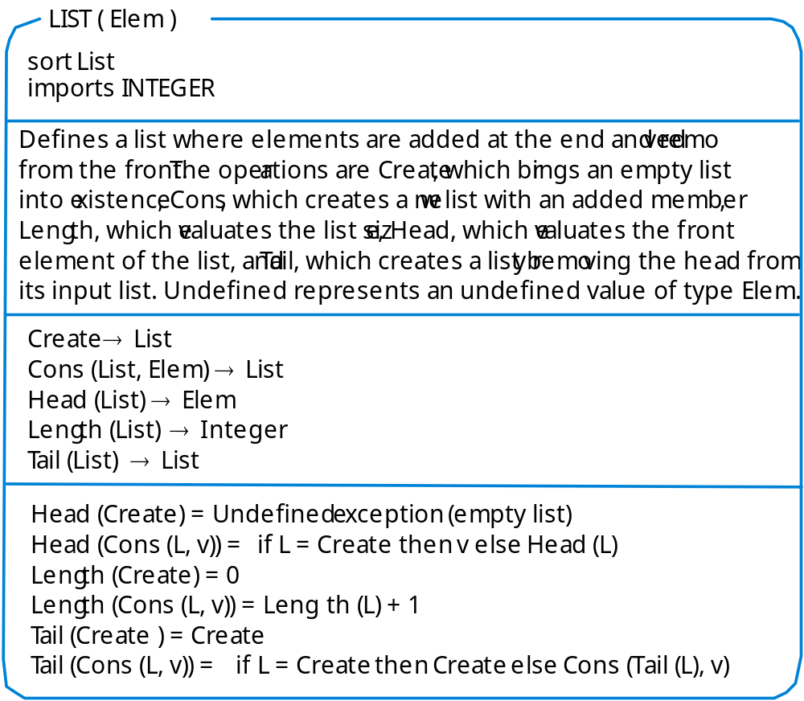
List specification

Slide 23
Recursion in specifications
Operations are often specified recursively.
Tail (Cons (L, v)) = if L = Create then Create
else Cons (Tail (L), v).
  Cons ([5, 7], 9) = [5, 7, 9]
  Tail ([5, 7, 9]) = Tail (Cons ( [5, 7], 9)) =
  Cons (Tail ([5, 7]), 9) = Cons (Tail (Cons ([5], 7)), 9) =
  Cons (Cons (Tail ([5]), 7), 9) =
  Cons (Cons (Tail (Cons ([], 5)), 7), 9) =
  Cons (Cons ([Create], 7), 9) = Cons ([7], 9) = [7, 9]

Slide 24
Interface specification in critical systems
Consider an air traffic control system where aircraft fly through managed sectors of airspace.
Each sector may include a number of aircraft but, for safety reasons, these must be separated.
In this example, a simple vertical separation of 300m is proposed.
The system should warn the controller if aircraft are instructed to move so that the separation rule is breached.

Slide 25
A sector object
Critical operations on an object representing a controlled sector are
  Enter. Add an aircraft to the controlled airspace;
  Leave. Remove an aircraft from the controlled airspace;
  Move. Move an aircraft from one height to another;
  Lookup. Given an aircraft identifier, return its current height;

Slide 26
Primitive operations
It is sometimes necessary to introduce additional operations to simplify the specification.
The other operations can then be defined using these more primitive operations.
Primitive operations
  Create. Bring an instance of a sector into existence;
  Put. Add an aircraft without safety checks;
  In-space. Determine if a given aircraft is in the sector;
  Occupied. Given a height, determine if there is an aircraft within 300m of that height.

Slide 27
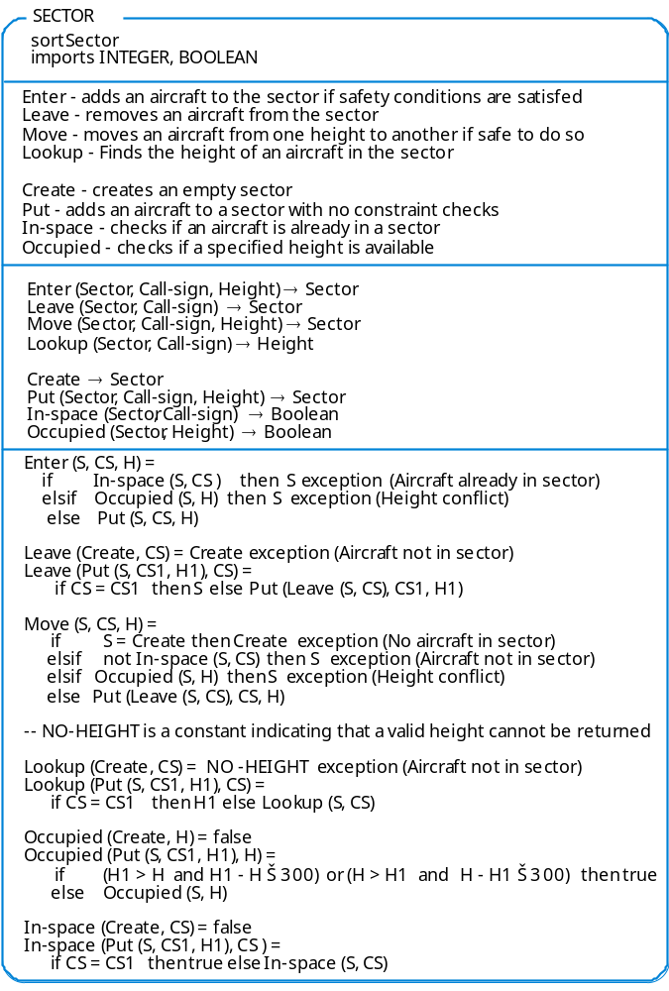
Sector specification (1)

Slide 28
Sector specification (2)

Slide 29
Specification commentary
Use the basic constructors Create and Put to specify other operations.
Define Occupied and In-space using Create and Put and use them to make checks in other operation definitions.
All operations that result in changes to the sector must check that the safety criterion holds.

Slide 30
Behavioural specification
Algebraic specification can be cumbersome when the object operations are not independent of the object state.
Model-based specification exposes the system state and defines the operations in terms of changes to that state.
The Z notation is a mature technique for model-based specification. It combines formal and informal description and uses graphical highlighting when presenting specifications.

Slide 31
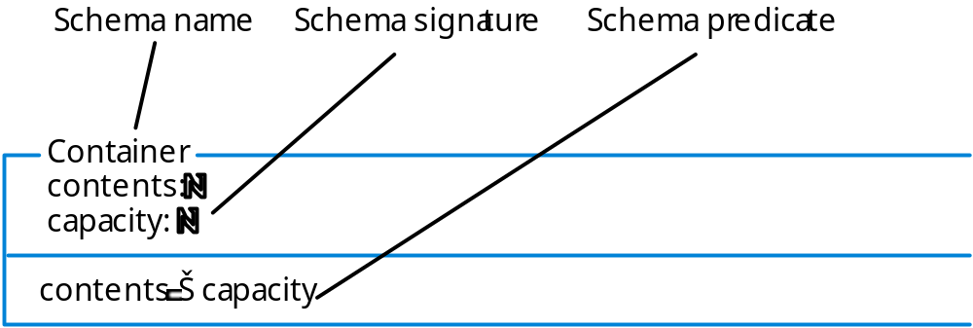
The structure of a Z schema

Slide 32
Modelling the insulin pump
The Z schema for the insulin pump declares a number of state variables including:
  Input variables such as switch? (the device switch), InsulinReservoir? (the current quantity of insulin in the reservoir) and Reading? (the reading from the sensor);
  Output variables such as alarm! (a system alarm), display1!, display2! (the displays on the pump) and dose! (the dose of insulin to be delivered).

Slide 33
Schema invariant
Each Z schema has an invariant part which defines conditions that are always true.
For the insulin pump schema it is always true that
  The dose must be less than or equal to the capacity of the insulin reservoir;
  No single dose may be more than 4 units of insulin and the total dose delivered in a time period must not exceed 25 units of insulin. This is a safety constraint;
  display2! shows the amount of insulin to be delivered.

Slide 34
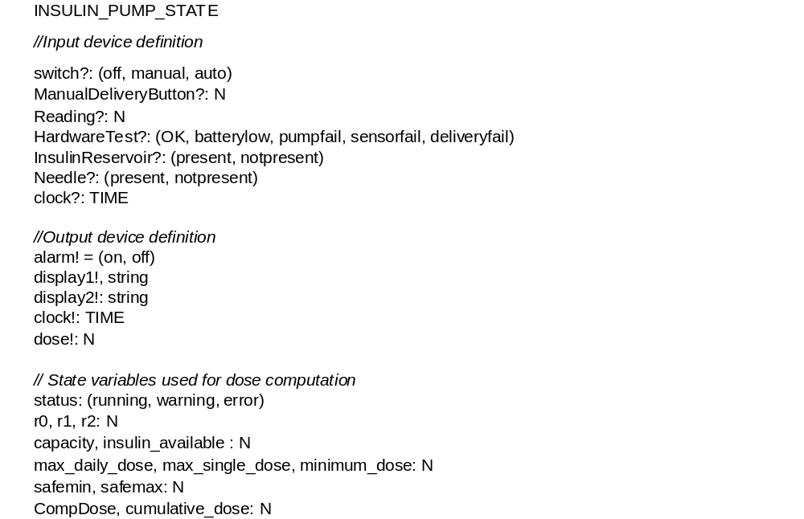
Insulin pump schema

Slide 35
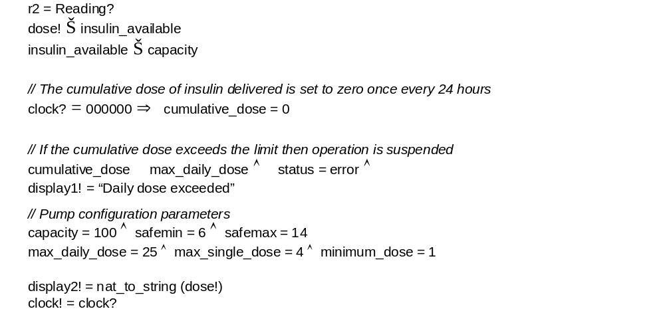
State invariants

Slide 36
The dosage computation
The insulin pump computes the amount of insulin required by comparing the current reading with two previous readings.
If these suggest that blood glucose is rising then insulin is delivered.
Information about the total dose delivered is maintained to allow the safety check invariant to be applied.
Note that this invariant always applies - there is no need to repeat it in the dosage computation.

Slide 37
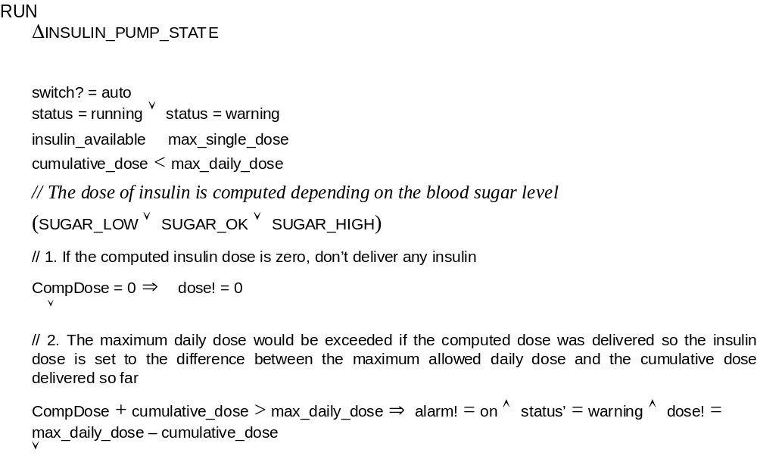
RUN schema (1)

Slide 38
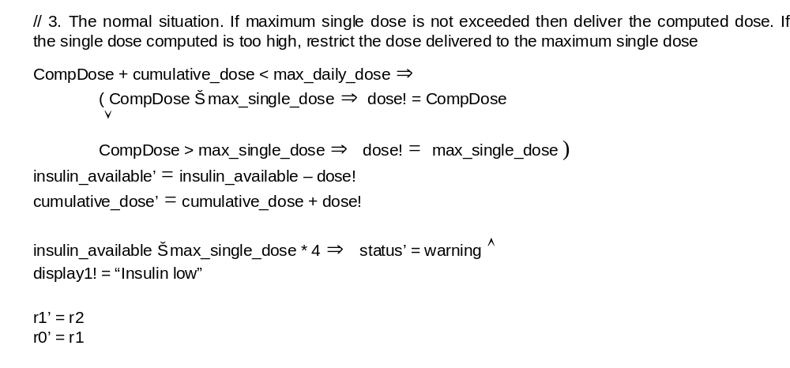
RUN schema (2)

Slide 39
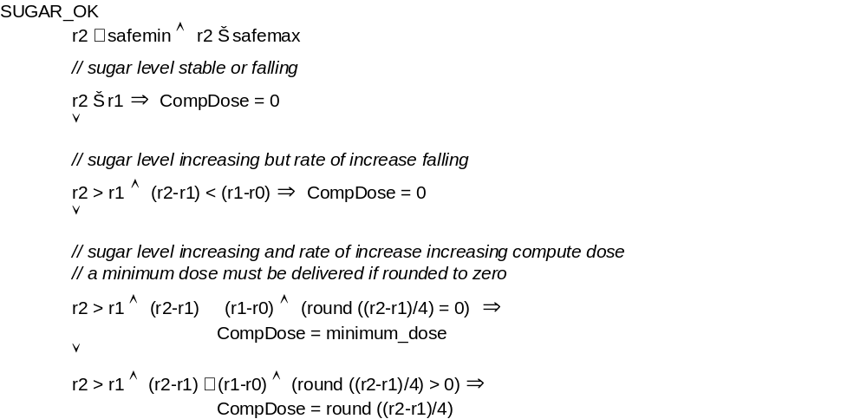
Sugar OK schema

Slide 40
Key points
Formal system specification complements informal specification techniques.
Formal specifications are precise and unambiguous. They remove areas of doubt in a specification.
Formal specification forces an analysis of the system requirements at an early stage. Correcting errors at this stage is cheaper than modifying a delivered system.
Formal specification techniques are most applicable in the development of critical systems and standards.

Slide 41
Key points
Algebraic techniques are suited to interface specification where the interface is defined as a set of object classes.
Model-based techniques model the system using sets and functions. This simplifies some types of behavioural specification.
Operations are defined in a model-based spec. by defining pre and post conditions on the system state.

